Slide 1


Christopher Garner
October 2021

Slide 2

Outline
Executive Summary
Introduction
Methodology
Results
Conclusion
Appendix

Slide 3
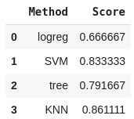
Executive Summary
We have gathered cleaned and analyzed data from SpaceX to reveal that we can predict the likelihood of a successful launch with an 86% success rate by using k nearest neighbor

Slide 4
Introduction
We want to be able to predict how landing performance will be effected by orbit, payload, launch site, landing pad, rocket type, and reused status.

Slide 5


Slide 6
Methodology
Executive Summary
Data collection methodology:
  API calls and web scraping
Perform data wrangling
  Success / Failure binary created
Perform exploratory data analysis (EDA) using visualization and SQL
Perform interactive visual analytics using Folium and Plotly Dash
Perform predictive analysis using classification models
  How to build, tune, evaluate classification models

Slide 7

Data Collection
Data is collected by making a series of API calls and inserting the results into Data frames.
These data frames are then cleaned for the information that we want and formatted.

Slide 8

Data Collection – SpaceX API
https://github.com/undeadcycle/Capstone/blob/main/Data%20Collection.ipynb

Slide 9
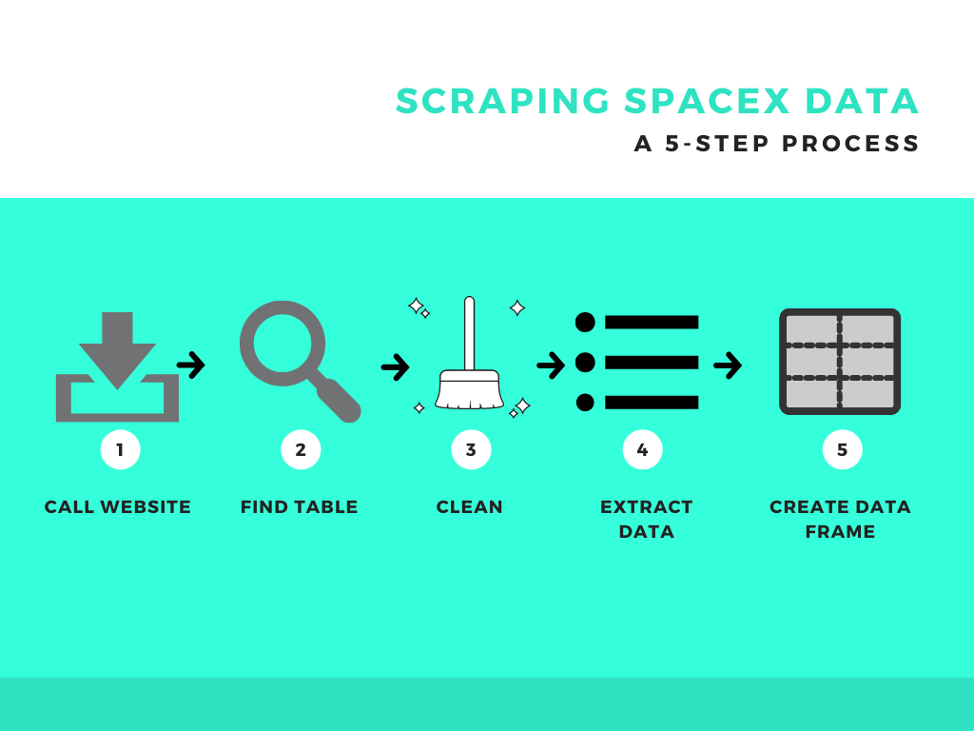
Data Collection - Scraping
https://github.com/undeadcycle/Capstone/blob/main/Web_Scrape.ipynb

Slide 10
Data Wrangling
In order to predict a successful outcome, we need to know what a successful outcome is. There are seven possible outcomes in the data that we currently have. If we classify all outcomes with “false” or “none” as a negative outcome, we can then assign everything else a positive outcome; leaving us with a simple one or zero representation.
https://github.com/undeadcycle/Capstone/blob/main/Data%20Wrangling.ipynb

Slide 11
EDA with Data Visualization
Comparisons presented:
Pay load Mass VS Flight Number (Scatter)
Launch Site VS Flight Number (Scatter)
Launch Site VS Pay load Mass (Scatter)
% Success Rate VS Orbit (Bar)
Orbit VS Flight Number (Scatter)
Orbit VS Pay load Mass (Scatter)
Success rate VS Year (Line)
https://github.com/undeadcycle/Capstone/blob/main/matplotlib.ipynb

Slide 12
EDA with SQL
Display the names of the unique launch sites in the space mission
Display 5 records where launch sites begin with the string 'CCA'
Display the total payload mass carried by boosters launched by NASA (CRS)
Display average payload mass carried by booster version F9 v1.1
List the date when the first successful landing outcome in ground pad was achieved
List the names of the boosters which have success in drone ship and have payload mass greater than 4000 but less than 6000
List the total number of successful and failure mission outcomes
List the names of the booster_versions which have carried the maximum payload mass. Use a subquery
List the failed landing_outcomes in drone ship, their booster versions, and launch site names for in year 2015
Rank the count of landing outcomes (such as Failure (drone ship) or Success (ground pad)) between the date 2010-06-04 and 2017-03-20, in descending order
https://github.com/undeadcycle/Capstone/blob/main/SQL.ipynb

Slide 13
Build an Interactive Map with Folium
We have marked all launch sites on the map with the number of launches and which launches were success and failure. We have also drawn lines to nearby locations and calculated that distance.
https://nbviewer.org/github/undeadcycle/Capstone/blob/main/Folium%280%29.ipynb

Slide 14
Build a Dashboard with Plotly Dash
We have created an interactive pie chart that can be modified based on launch site. We also have a success vs payload which can be tuned by site and payload range.
https://github.com/undeadcycle/Capstone/blob/main/dash1.ipynb

Slide 15
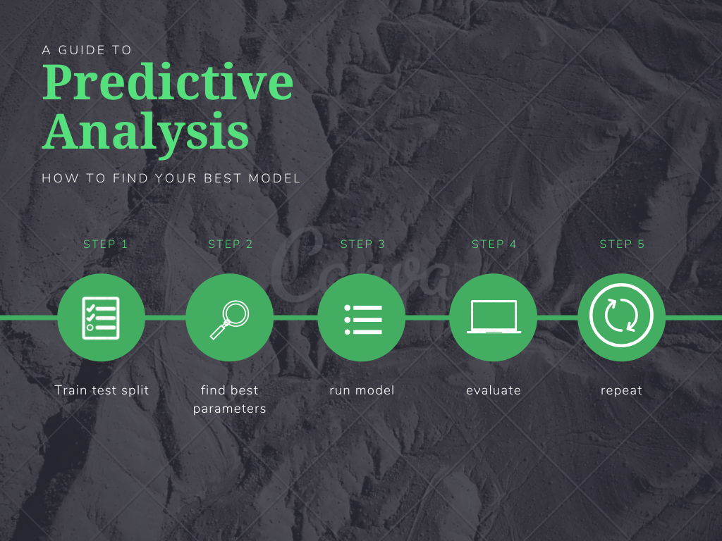
Predictive Analysis (Classification)
https://github.com/undeadcycle/Capstone/blob/main/ML.ipynb

Slide 16
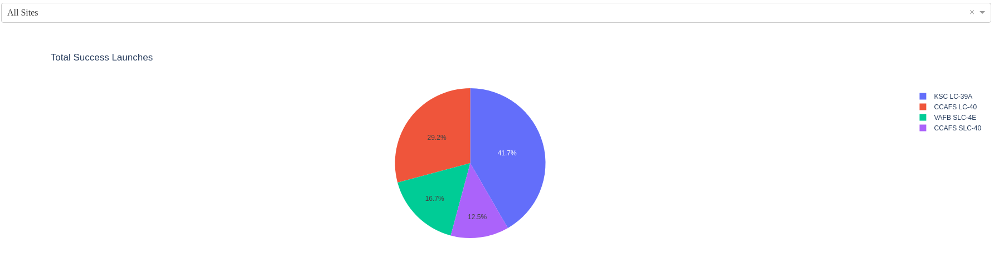
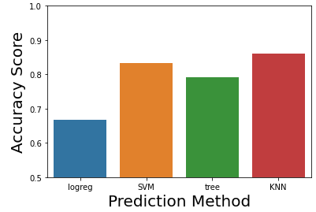
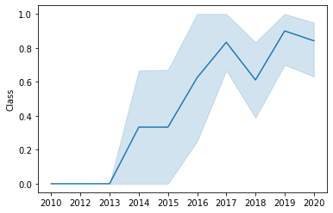
Results

Slide 17


Slide 18
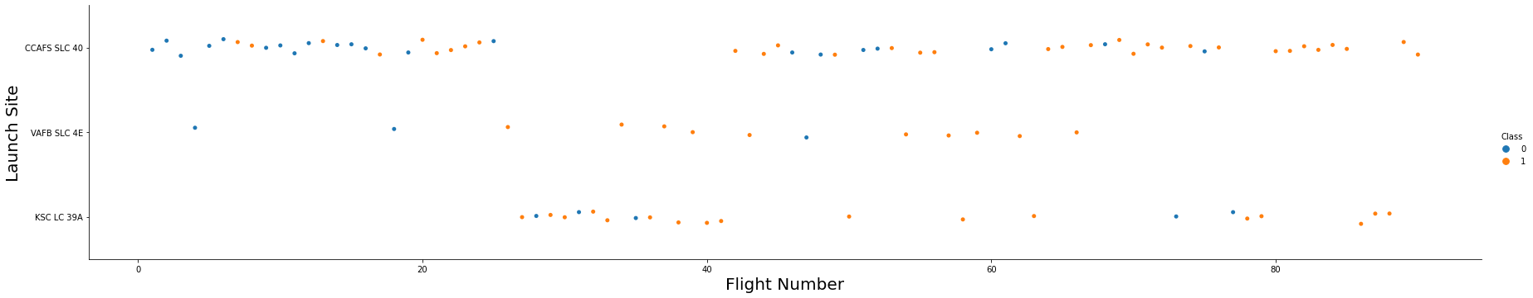
Flight Number vs. Launch Site
It looks as though CCAFS SLC 40 is the main launch site; but for launches around the 30-40 mark some resources may have been diverted to KSC LC 39A

Slide 19
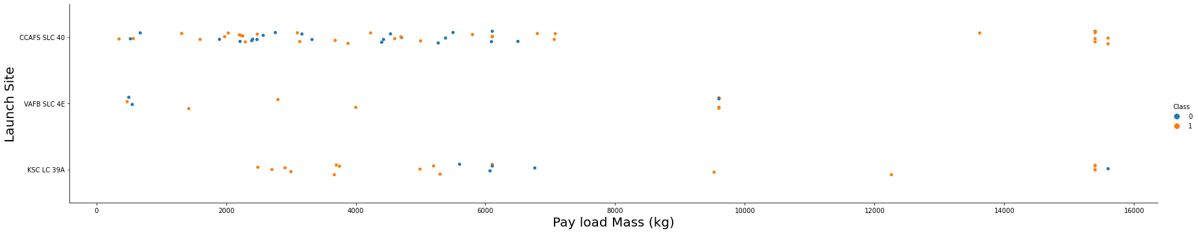
Payload vs. Launch Site
When the pay load is between 8000kg and 14,000kg site VAFB SLC 4E seems to be preferred
This range also seems to have fewer launches than the ranges above or below

Slide 20
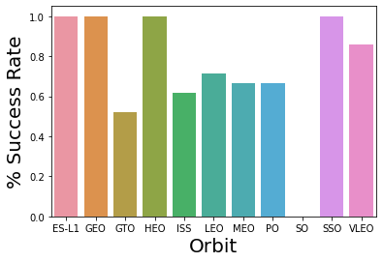
Success Rate vs. Orbit Type
We can see 4 orbits with a 100% success rate
We also see 1 orbit with a 0% success rate
Could the difficulty of each orbit type be signaled by is success rate?

Slide 21
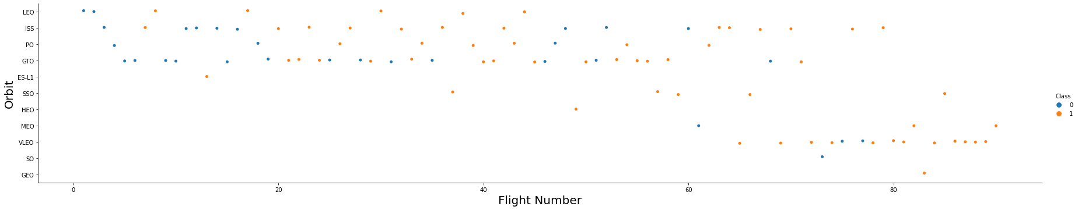
Flight Number vs. Orbit Type
It seems as though the focus was on 4 orbits, especially towards the beginning
VLEO seems to be the new interest

Slide 22
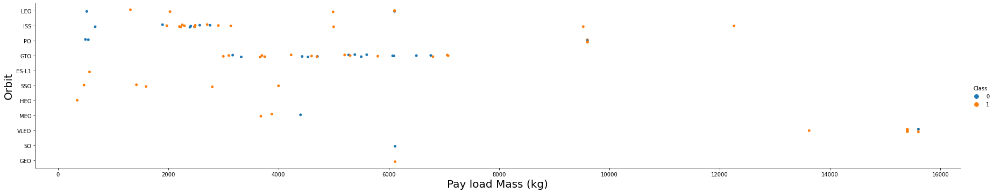
Payload vs. Orbit Type
Though this does not show time; They may have been consistently pushing the weight limits on orbits like ISS and GTO

Slide 23
Launch Success Yearly Trend
With the exception of 2018 and 2020 the trend is upward and with the number of orbits having 100% success I would expect this to continue to climb

Slide 24
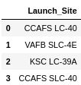
All Launch Site Names
The names of 4 launch sites

Slide 25
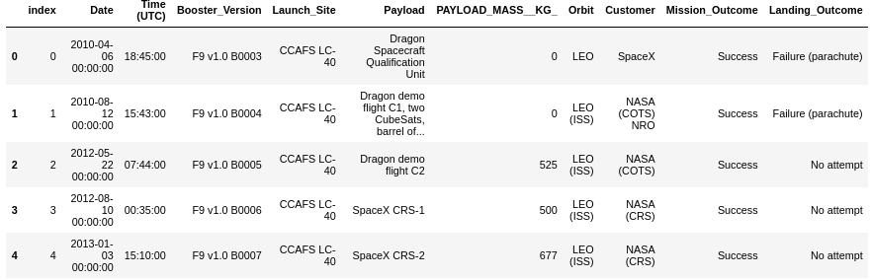
Launch Site Names Begin with 'CCA'
5 records where launch sites begin with the string 'CCA'

Slide 26

Total Payload Mass
The total payload carried by boosters from NASA was 111,268 kg

Slide 27

Average Payload Mass by F9 v1.1
The average payload mass carried by booster version F9 v1.1 was 2534.666667 kg

Slide 28

First Successful Ground Landing Date
The first successful landing outcome on ground pad was 12/22/2015

Slide 29
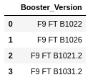
Successful Drone Ship Landing with Payload between 4000 and 6000
Boosters which have successfully landed on drone ship and had payload mass greater than 4000 but less than 6000 are:
F9 FT B1022
F9 FT B1026
F9 FT B1021.2
F9 FT B1031.2

Slide 30


Total Number of Successful and Failure Mission Outcomes
Success
Failure

Slide 31
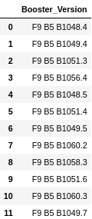
Boosters Carried Maximum Payload
Boosters which have carried the maximum payload mass

Slide 32

2015 Launch Records
Failed landing_outcomes in drone ship, their booster versions, and launch site names for in year 2015

Slide 33
Rank Landing Outcomes Between 2010-06-04 and 2017-03-20
Rank the count of landing outcomes (such as Failure (drone ship) or Success (ground pad)) between the date 2010-06-04 and 2017-03-20, in descending order
Present your query result with a short explanation here

Slide 34


Slide 35
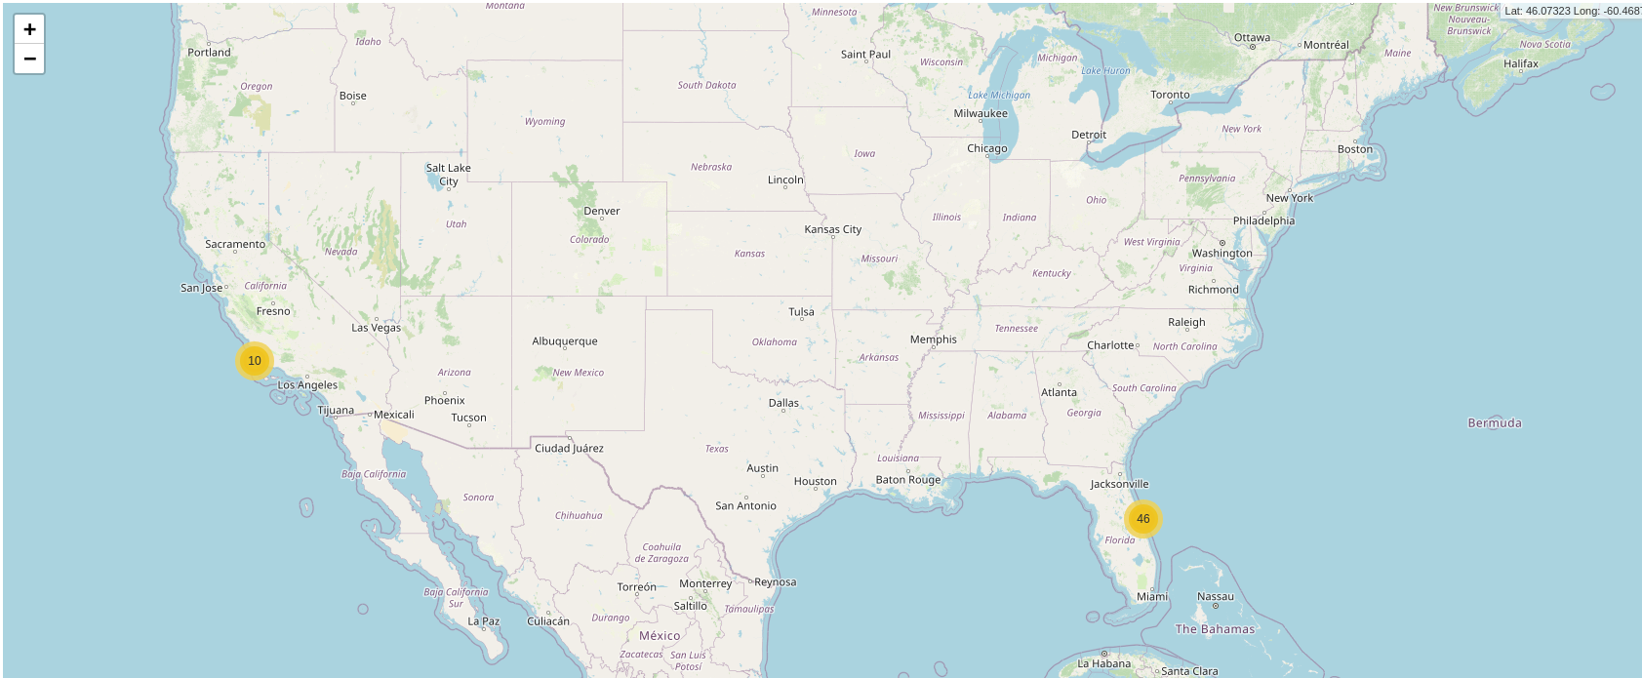
Global Launch sites
Locations and number of launches

Slide 36
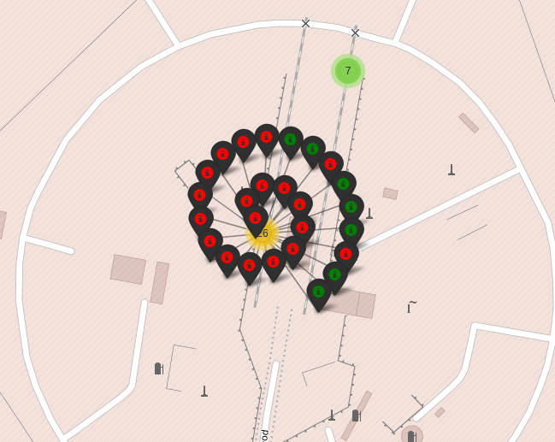
Outcomes
Show success vs failure

Slide 37
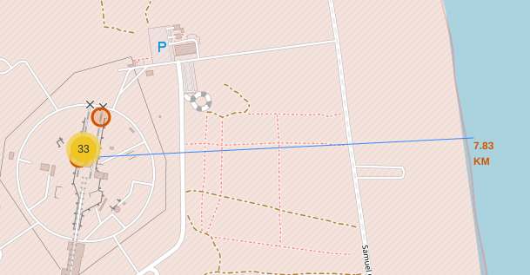
Proximities
Distance to nearby coastline

Slide 38


Slide 39
Total Successful Launches
KSC LC 39A has the most successful launces

Slide 40
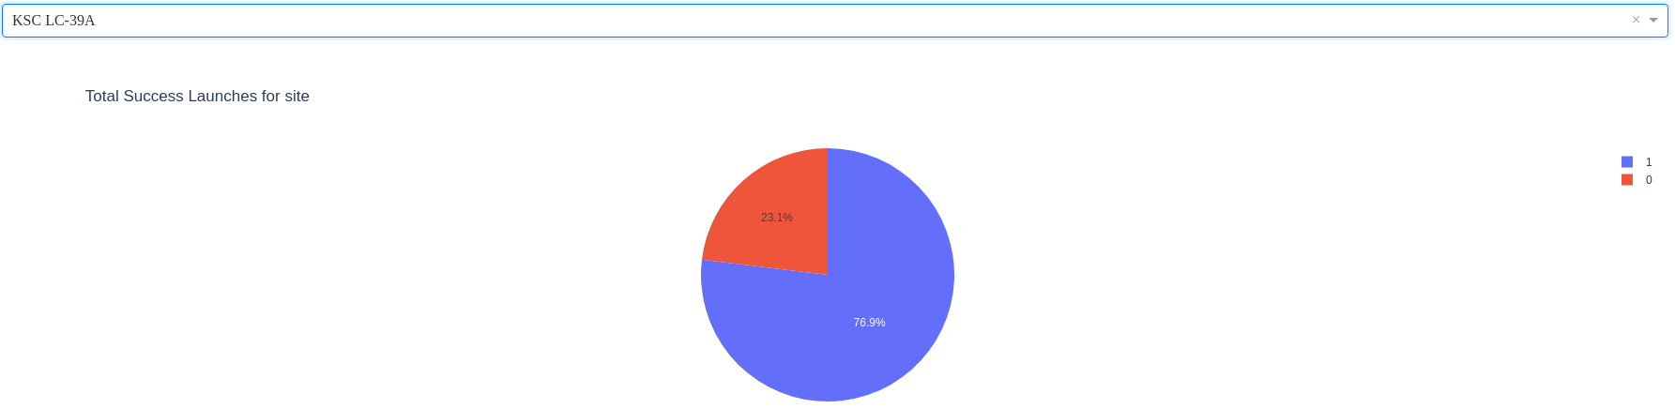
Site with highest % of success
KSC LC 39A
This is the same site with the highest percentage overall

Slide 41
<Dashboard Screenshot 3>
Replace <Dashboard screenshot 3> title with an appropriate title
Show screenshots of Payload vs. Launch Outcome scatter plot for all sites, with different payload selected in the range slider
Explain the important elements and findings on the screenshot, such as which payload range or booster version have the largest success rate, etc.

Slide 42


Slide 43
Classification Accuracy
K Nearest Neighbor has the highest classification accuracy

Slide 44
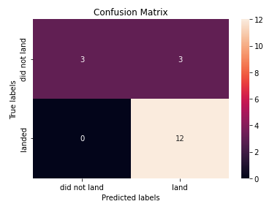
Confusion Matrix
3 False positives
0 False negatives

Slide 45
Conclusions
Now we can assess the likely success of a mission based on parameters, which gives us the ability to tune parameters to make success more likely.

Slide 46
Appendix
https://github.com/undeadcycle/Capstone/blob/main/Data%20Collection.ipynb
https://github.com/undeadcycle/Capstone/blob/main/Data%20Wrangling.ipynb
https://nbviewer.org/github/undeadcycle/Capstone/blob/main/Folium%280%29.ipynb
https://github.com/undeadcycle/Capstone/blob/main/ML.ipynb
https://github.com/undeadcycle/Capstone/blob/main/SQL.ipynb
https://github.com/undeadcycle/Capstone/blob/main/Web_Scrape.ipynb
https://github.com/undeadcycle/Capstone/blob/main/dash1.ipynb
https://github.com/undeadcycle/Capstone/blob/main/matplotlib.ipynb

Slide 47


